Slide 1
Women in Data COVID-19 Hackathon
BY ROAD NOT TAKEN

Slide 2



Women behind “Road not taken” team
Laura Maio
Insight & Evaluation Adviser
United Kingdom, London
Lillian Zhang
Data Scientist
Australia, Sydney
Gavita Regunath
System Engineer
United Kingdom, Kenilworth

Slide 3
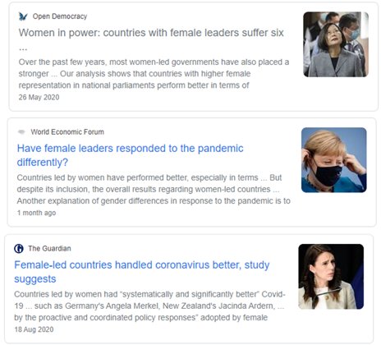
Women Parliamentarians in the fight against COVID-19
Motivation of this research is to do with the effectiveness of female parliamentarians in handling the COVID crisis
Recent media articles have suggested that women-led countries are doing better in terms of their responses to the COVID-19 pandemic
“Current data shows that countries with women in a leadership position have suffered six times fewer confirmed deaths from Covid-19 than countries with governments led by men.”
Source: Open Democracy – Women in power: countries with female leaders suffer six times fewer Covid deaths and will recover sooner from recession

Slide 4
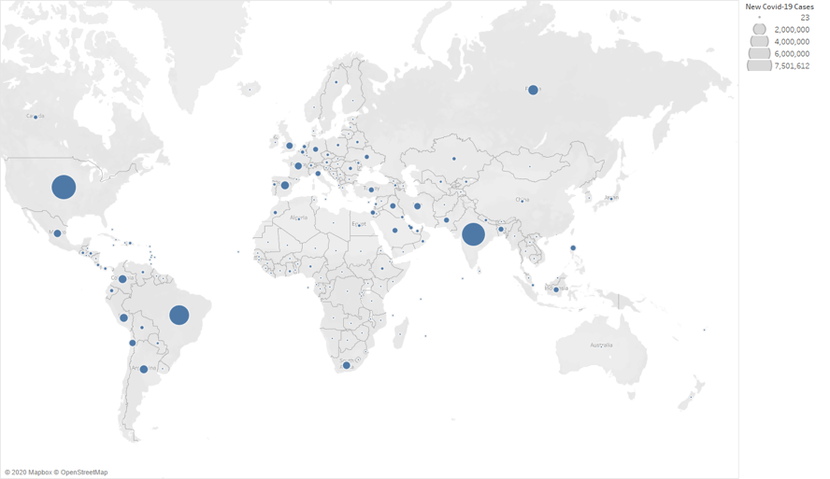
Global COVID-19 cases

Slide 5
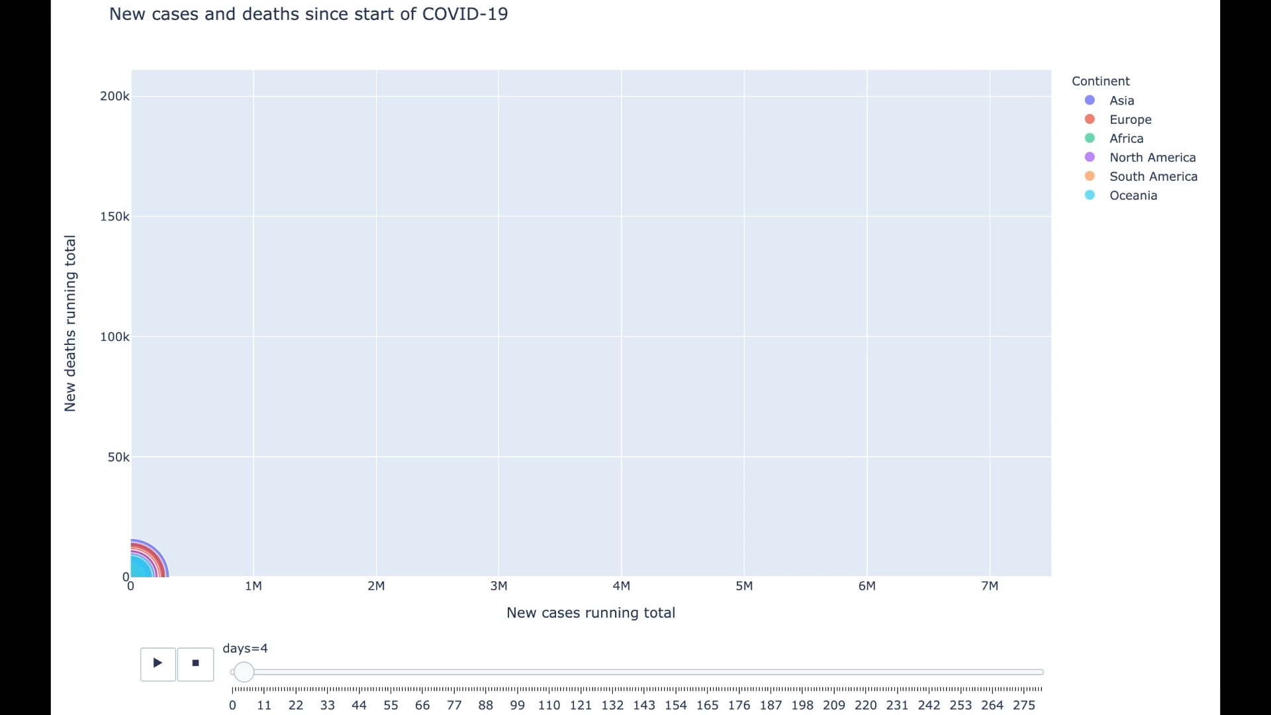
Global COVID-19 cases
Size of circles = GDP-PPP

Slide 6
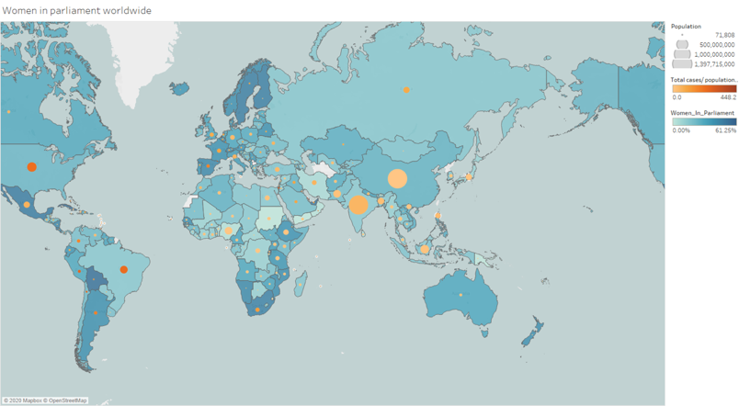
Women in Parliament
Women in Parliament: The percentage of parliamentary seats in a single or lower chamber held by women as of 2019 estimates.

Slide 7
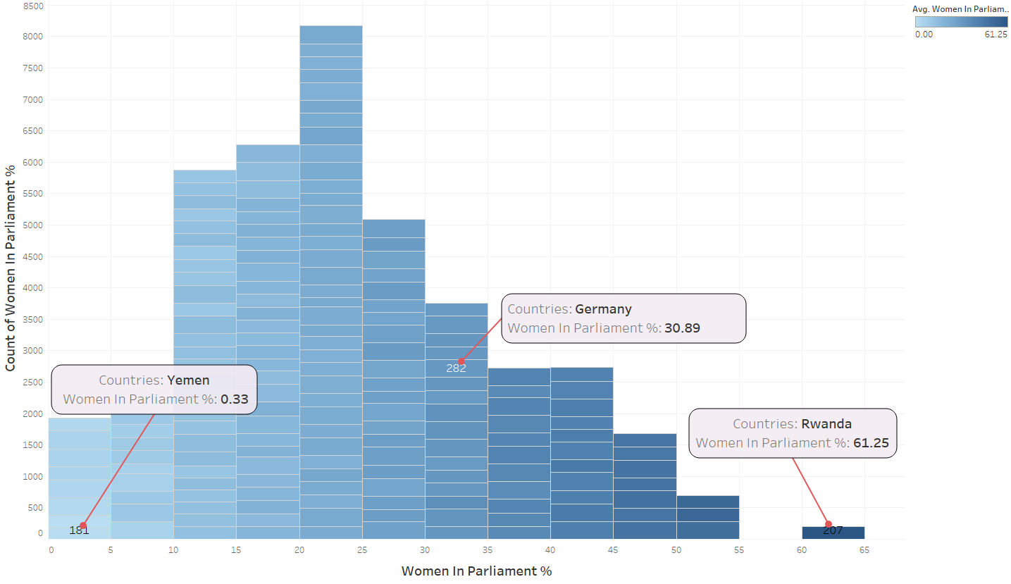
Distribution of Women in Parliament
Rwanda has the highest number of women parliamentarians worldwide
Yemen has the lowest number of women parliamentarians worldwide

Slide 8
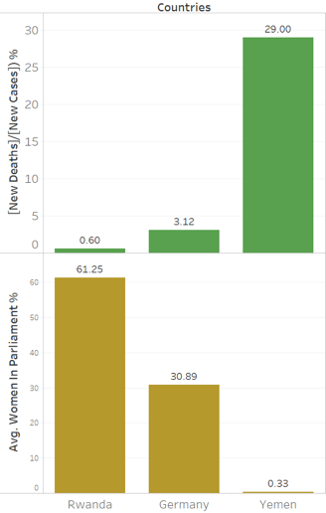
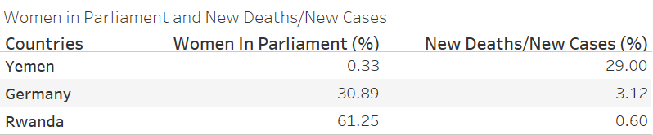
Number of Deaths vs. WIP
Data shows that Rwanda who has the highest women in parliament has the lowest number of deaths (relative to the number of recorded cases).
Yemen who has the lowest women in parliament has the highest number of deaths.
This results support the reports stating that countries with women in position of leadership have suffered few confirmed deaths from Covid-19 as countries with governments led by men.

Slide 9
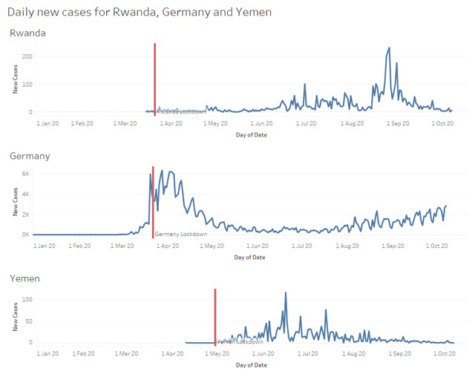
Timing of lockdown
Data shows that Rwanda imposed their lockdown earlier than Yemen.
Women leaders generally are more risk averse with regard to lives.
Hence, they were prepared to take significant risks with their economies by locking down early compared to their male-led countries.

Slide 10
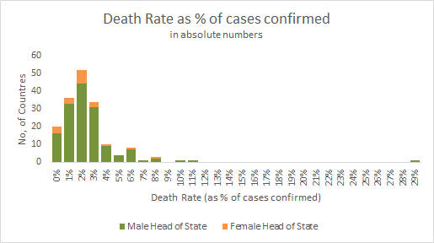
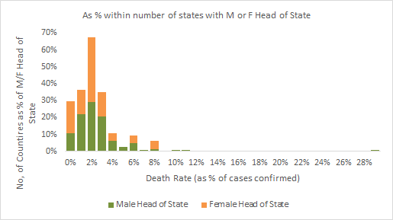
Women as Head of State
However a Kruskal-Wallis H test performed on our dataset showed that there was no statistically significant difference in the death rate (number of deaths as percentage of cases confirmed) between countries with men or women as head of State, χ2(2) = 0.308, p = 0.579, with a mean rank of 86.79 for countries with a male Head of State, and 80.38 for countries with a female Head of State.
This appears to be in contradiction with the published findings.

Slide 11
Summary
COVID-19 has changed many things in our daily lives
Statistically, female-led countries (as of publication), were quicker to lockdown and had fewer COVID fatalities than comparable, male-led countries
Our findings appear to go partly in the same direction of the published results, and partly to disconfirm them.
As the response to the pandemic is complex and multi-factorial, it is possible that our dataset was not sufficiently granular to appropriately explore the impact of women in power over the COVID-19 outcomes. More work is needed to explore more granular indicators and the mix of factors that have made some countries’ response more effective.

Slide 12
Thank you!
Road not taken – Team 10

